Slide 1
Genomic Regions Flanking E-Box Binding Sites Influence DNA Binding Specificity of bHLH Transcription Factors through DNA Shape
Raluca Gordan, Ning Shen, Iris Drore et al.
Published in NCBI (National Center for Biotechnology)
Sunwoo Yim

Slide 2
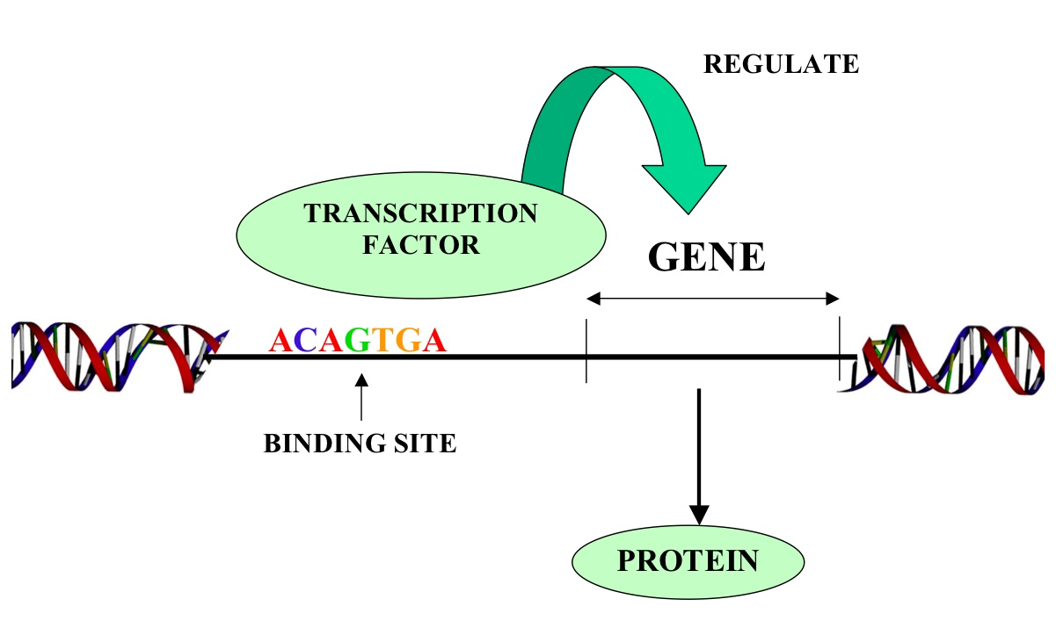
TF binding specificity to DNA sequences

Slide 3
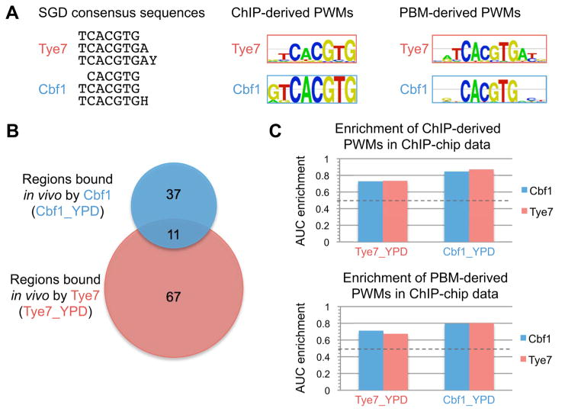
Notes:
Chromatin immunoprecipitation- Living tissues or cells
Microarrays in lab

Slide 4
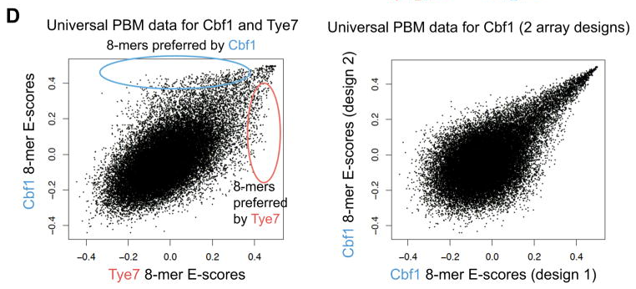

Slide 5
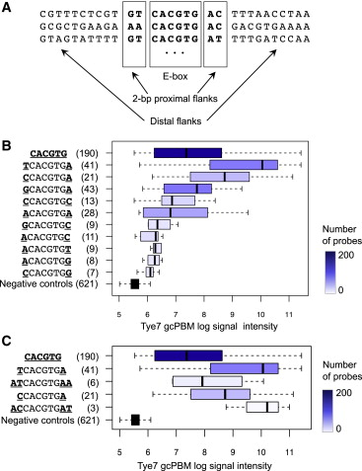
gcPBM- variation of universal PBM

Slide 6
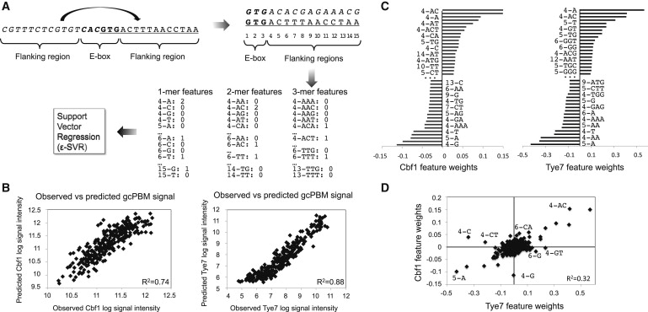


Slide 7
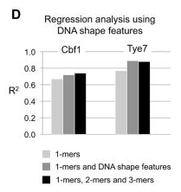
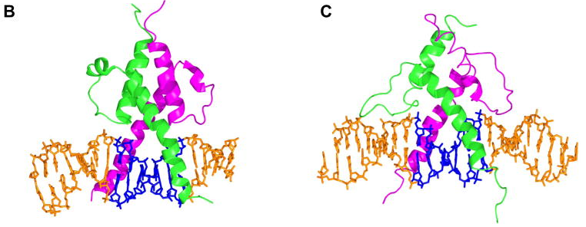

Slide 8
Bibliography
Gordân, Raluca et al. “Genomic Regions Flanking E-Box Binding Sites Influence DNA Binding Specificity of bHLH Transcription Factors through DNA Shape.” Cell reports 3.4 (2013): 1093–104. Web. 4 Mar. 2015.
http://www.bio.miami.edu/dana/pix/transcription_factor.jpg

Slide 9
Questions?

